Slide 1
Supervised Learning
Linear Regression
with multiple variables
Some slides taken from Andrew Ng’s Machine Learning course https://www.coursera.org/learn/machine-learning

Slide 2
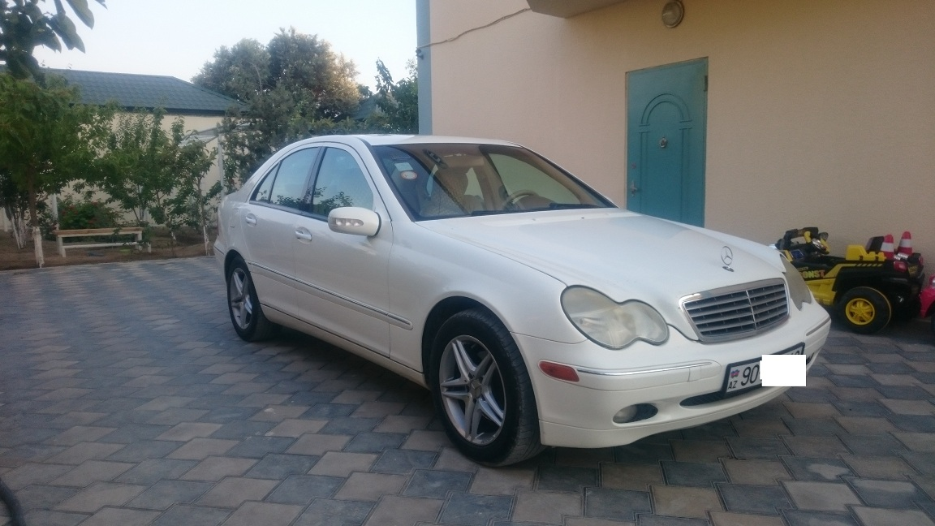


Predicting car prices
How much is my car worth?

Slide 3
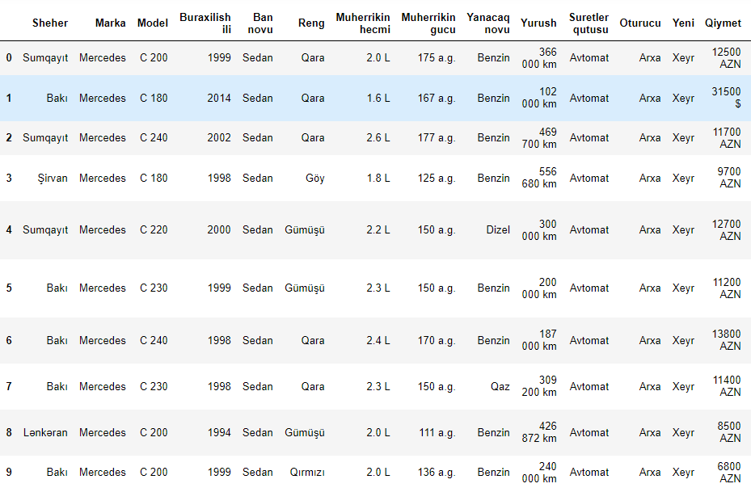
Data from turbo.az for C class-Mercedes

Slide 4


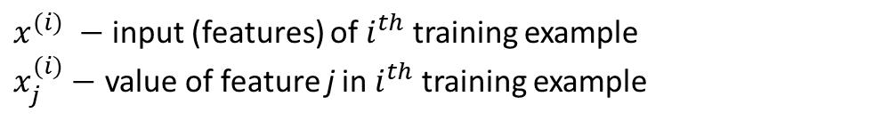
Multiple features (variables).
Index | Model | Year | Mileage | Engine capacity | Color | Price
1 | C 200 | 1999 | 366000 km | 2.0 | black | 12500AZN
2 | C 180 | 2014 | 102000km | 1.6 | black | 31500$
3 | C 240 | 2002 | 469700km | 2.6 | Blue | 9700AZN
4 | C 220 | 2000 | 300000km | 2.2 | Silver | 12700AZN
… | … | … | … | … | … | …
Notation:
n – Number of training examples
d – number of features
x’s = “input” variable / features
y’s = “output” variable / “target” variable / label
$\left\{{(x}^{(i)},y^{(i)})\text{: }i=1,…n\right\}$ - training set
$${(x}^{(i)},y^{(i)})\text{ − }\text{training} \text{example}$$
$x^{(i)} −$ input (features) of $i^{th}$ training example
$x_{j}^{(i)}−$ value of feature j in $i^{th}$ training example
Notes:
Pop-up Quiz

Slide 5
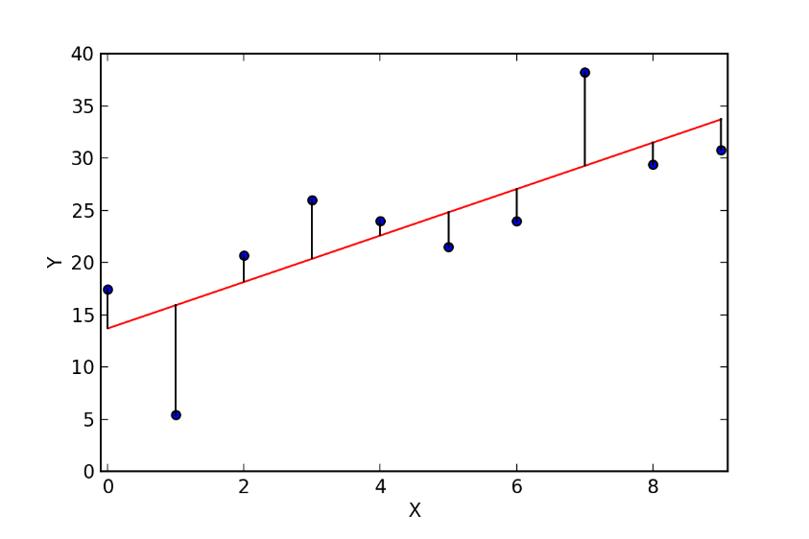




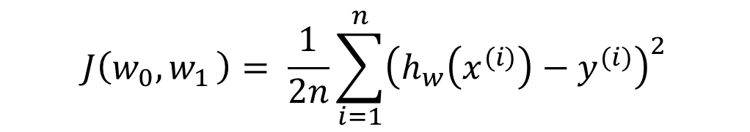
Linear Regression with one variable
Idea: Choose $w_{0},w_{1}$so that $h_{w}\left(x\right)$ is close to for our training examples ${(x}^{(i)},y^{(i)})$
Hypothesis:
$$h_{w}\left(x\right)=w_{0}+w_{1}x$$
Parameters:
$$w_{0},w_{1}$$
$$J\left(w_{0}{,w}_{1}\right)= \frac{1}{2n}\sum_{i=1}^{n}{{\left(h_{w}\left(x^{(i)}\right)−y^{(i)}\right)}^{2}}$$
Cost Function:
Goal:
min $J\left(w_{0}{,w}_{1}\right)$
$$w_{0},w_{1}$$

Slide 6
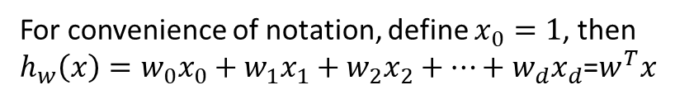
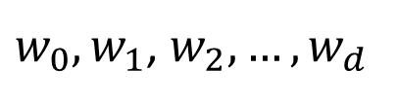
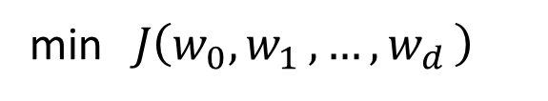
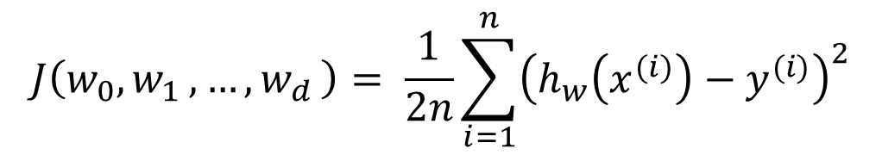
Linear Regression with multiple variables
Idea: Choose $w_{0},w_{1}{,w}_{2},…{,w}_{d}$ so that $h_{w}\left(x\right)$ is close to for our training examples ${(x}^{(i)},y^{(i)})$
Hypothesis:
$$h_{w}\left(x\right)=w_{0}+w_{1}x_{1}+w_{2}x_{2}+…+w_{d}x_{d}$$
For convenience of notation, define $x_{0}=1$, then
$h_{w}\left(x\right)=w_{0}x_{0}+w_{1}x_{1}+w_{2}x_{2}+…+w_{d}x_{d}$=$w^{T}x$
Parameters:
$w_{0},w_{1}$, $w_{2},…,w_{d}$
$$J\left(w_{0}{,w}_{1}{,…,w}_{d}\right)= \frac{1}{2n}\sum_{i=1}^{n}{{\left(h_{w}\left(x^{(i)}\right)−y^{(i)}\right)}^{2}}$$
Cost Function:
Goal:
min$J\left(w_{0}{,w}_{1}{,…,w}_{d}\right)$
w
Multivariate linear regression

Slide 7
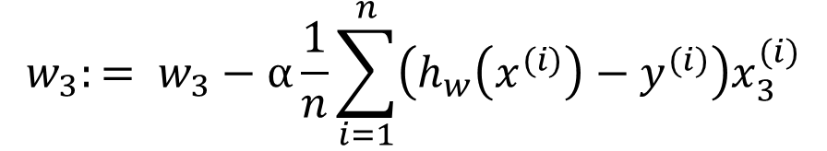
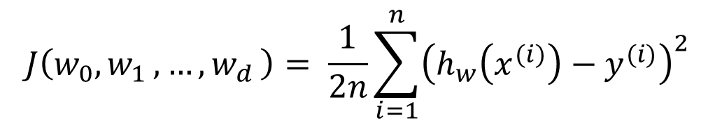
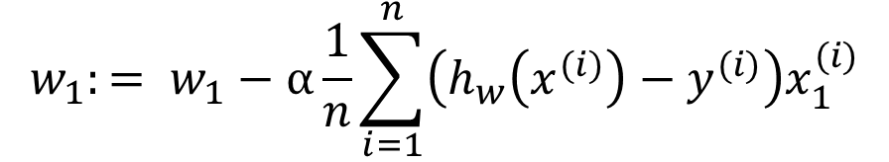
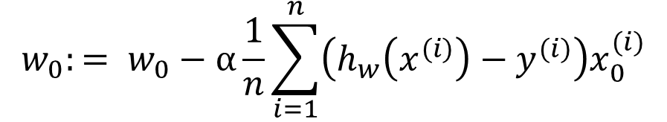
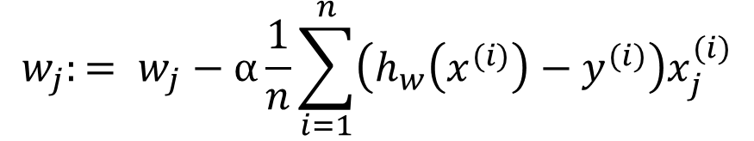
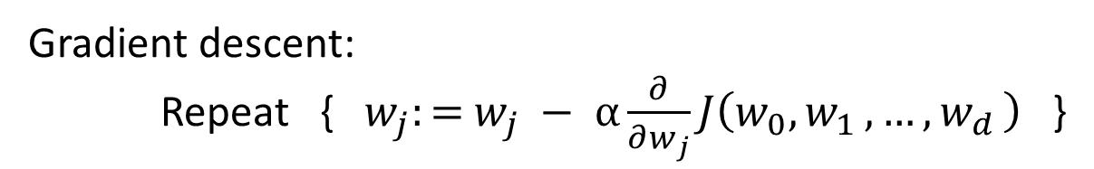
Gradient descent for multiple variables
$$J\left(w_{0}{,w}_{1}{,…,w}_{d}\right)= \frac{1}{2n}\sum_{i=1}^{n}{{\left(h_{w}\left(x^{(i)}\right)−y^{(i)}\right)}^{2}}$$
Cost Function:
Gradient descent:
Repeat {${ w}_{j}:=$ $w_{j} − α\frac{∂}{∂w_{j}}J\left(w_{0}{,w}_{1}{,…,w}_{d}\right)$ }
(simultaneously update for every j = 0,1,…,d)
$$w_{j}:= w_{j}−α\frac{1}{n}\sum_{i=1}^{n}{\left(h_{w}\left(x^{(i)}\right)−y^{(i)}\right)x_{j}^{(i)}}$$
$$w_{0}:= w_{0}−α\frac{1}{n}\sum_{i=1}^{n}{\left(h_{w}\left(x^{(i)}\right)−y^{(i)}\right)x_{0}^{(i)}}$$
$$w_{3}:= w_{3}−α\frac{1}{n}\sum_{i=1}^{n}{\left(h_{w}\left(x^{(i)}\right)−y^{(i)}\right)x_{3}^{(i)}}$$
$$w_{1}:= w_{1}−α\frac{1}{n}\sum_{i=1}^{n}{\left(h_{w}\left(x^{(i)}\right)−y^{(i)}\right)x_{1}^{(i)}}$$

Slide 8

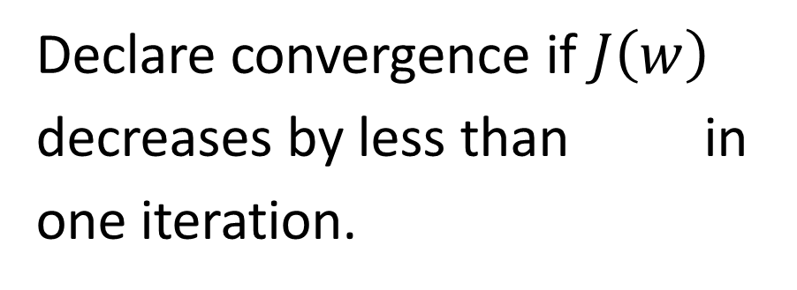

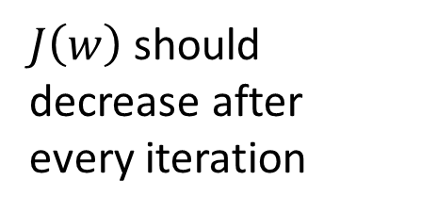
“Debugging”: Making sure gradient descent is working correctly.
min$J\left(w\right)$
w
Example automatic convergence test:
$J\left(w\right)$ should decrease after every iteration
Declare convergence if $J\left(w\right)$ decreases by less than in one iteration.
No. of iterations

Slide 9




Making sure gradient descent is working correctly.
$$J\left(w\right)$$
Gradient descent not working.
No. of iterations
Use smaller .
$$J\left(w\right)$$
No. of iterations
For sufficiently small should decrease on every iteration.
But if is too small, gradient descent can be slow to converge.
$$J\left(w\right)$$

Slide 10


Summary:
If is too small: slow convergence.
If is too large: may not decrease on every iteration; may not converge.
To choose , try

Slide 11








Feature scaling methods
E.g. = Engine Capacity (1.6-3.0)
= Mileage (0-500000km)
The goal of feature scaling is to transform features to be on a similar scale.
$$w_{2}$$
$$J\left(w\right)$$
$$w_{2}$$
$$J\left(w\right)$$
$$w_{1}$$
$$w_{1}$$

Slide 12

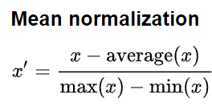
Feature scaling methods
Min-max normalization. The values in the column are transformed using the following formula:
The min-max normalizer linearly rescales every feature to the [0,1] interval.
←Range
←Range
https://en.wikipedia.org/wiki/Normalization_(statistics)

Slide 13




Feature scaling methods
Standardization (Z-score Normalization)
Feature standardization makes the values of each feature in the data have zero-mean and unit-variance.
Mean:
Standard Deviation:
(Do not apply to ).

Slide 14

Question
Suppose m=4 students have taken some class, and the class had a midterm exam and a final exam. You have collected a dataset of their scores on the two exams, which is as follows:
midterm exam | (midterm exam)2 | final exam
89 | 7921 | 96
72 | 5184 | 74
94 | 8836 | 87
69 | 4761 | 78
You'd like to use polynomial regression to predict a student's final exam score from their midterm exam score.
What is the mean normalized feature
Use feature scaling (dividing by range)

Slide 15
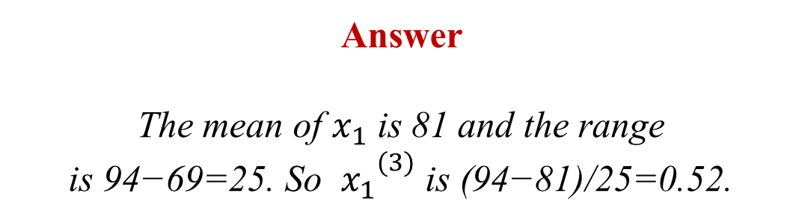


Slide 16
Question
You run gradient descent for 15 iterations with α=0.3 and compute J(w) after each iteration. You find that the value of J(w) increases over time. Based on this, which of the following conclusions seems most plausible?
A) Rather than use the current value of α, it'd be more promising to try a smaller value of α (say α=0.1)
B) Rather than use the current value of α, it'd be more promising to try a larger value of α (say α=1.0)
C) α=0.3 is an effective choice of learning rate.

Slide 17

Rather than use the current value of α, it'd be more promising to try a smaller value of α (say α=0.1)
Rather than use the current value of α, it'd be more promising to try a larger value of α (say α=1.0)
α=0.3 is an effective choice of learning rate.
Correct
Since the cost function is increasing, we know that gradient descent is diverging, so we need a lower learning rate.

Slide 18

Question
You run gradient descent for 15 iterations with α=0.3 and compute J(w) after each iteration. You find that the value of J(w) decreases quickly then levels off. Based on this, which of the following conclusions seems most plausible?
A) α=0.3 is an effective choice of learning rate
B) Rather than use the current value of α, it'd be more promising to try a larger value of α (say α=1.0)
C) Rather than use the current value of α, it'd be more promising to try a smaller value of α (say α=0.1)

Slide 19

α=0.3 is an effective choice of learning rate
Rather than use the current value of α, it'd be more promising to try a larger value of α (say α=1.0)
Rather than use the current value of α, it'd be more promising to try a smaller value of α (say α=0.1)
Correct
We want gradient descent to quickly converge to the minimum, so the current setting of α seems to be good.

Slide 20
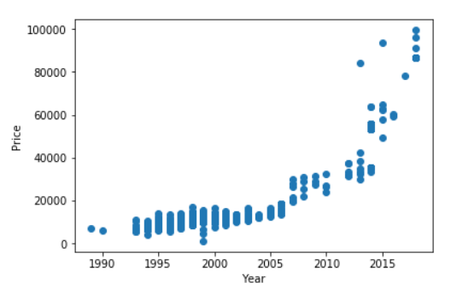



Polynomial Regression
$$h_{w}\left(x\right)=w_{0}+w_{1}x+w_{2}x^{2}$$
$$h_{w}\left(x\right)=w_{0}+w_{1}x+w_{2}x^{2}+w_{3}x^{3}$$
$$h_{w}\left(x\right)=w_{0}+w_{1}x+w_{2}\sqrt{x^{2}}$$
https://miro.medium.com/max/800/1*xz_haBuJRSI2DaveNk-3gw.gif

Slide 21
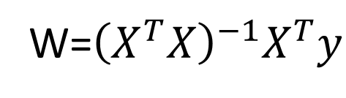
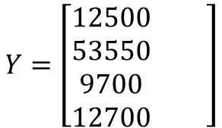
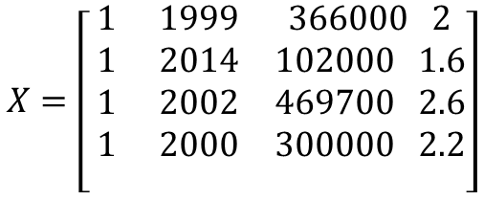
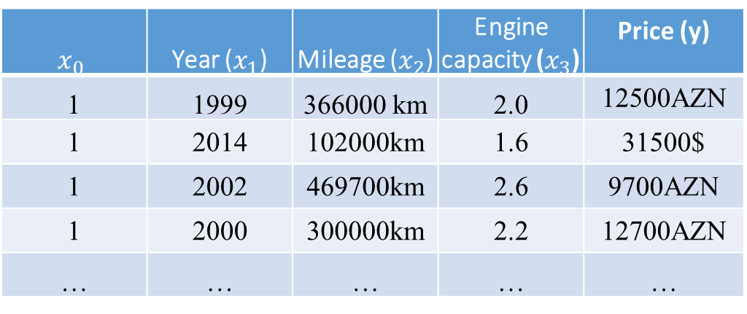
Normal equation: Method to solve for analytically.
$$x_{0}$$ | Year ($x_{1}$) | Mileage ($x_{2}$) | Engine capacity ($x_{3}$) | Price (y)
1 | 1999 | 366000 km | 2.0 | 12500AZN
1 | 2014 | 102000km | 1.6 | 31500$
1 | 2002 | 469700km | 2.6 | 9700AZN
1 | 2000 | 300000km | 2.2 | 12700AZN
… | … | … | … | …
$$X=\left[\begin{matrix}1 & 1999 & 366000 2 \\ 1 & 2014 & 102000 1.6 \\ 1 & 2002 & 469700 2.6 \\ 1 & 2000 & 300000 2.2 \\ & & \end{matrix}\right]$$
$$Y=\left[\begin{matrix}12500 & \\ 53550 & \\ 9700 & \\ 12700 & \end{matrix}\right]$$
W=${\left(X^{T}X\right)}^{−1}X^{T}y$
Notes:
Pop-up Quiz

Slide 22
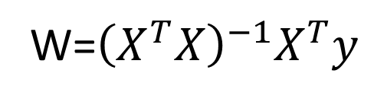
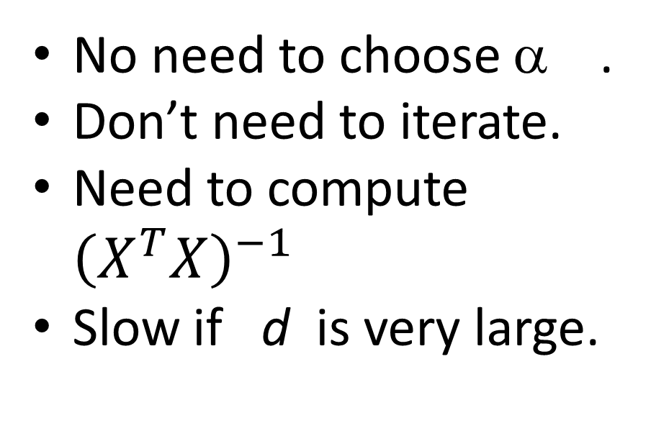

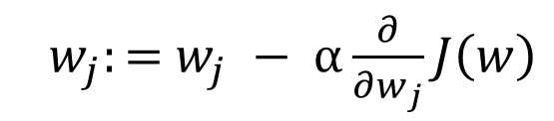
n training examples, d features.
Gradient Descent
Normal Equation
${ w}_{j}:=$ $w_{j} − α\frac{∂}{∂w_{j}}J\left(w\right)$
W=${\left(X^{T}X\right)}^{−1}X^{T}y$
Need to choose α .
Needs many iterations.
Works well even when d is large
No need to choose α .
Don’t need to iterate.
Need to compute ${\left(X^{T}X\right)}^{−1}$
Slow if d is very large.
$$O(n^{3})$$

Slide 23
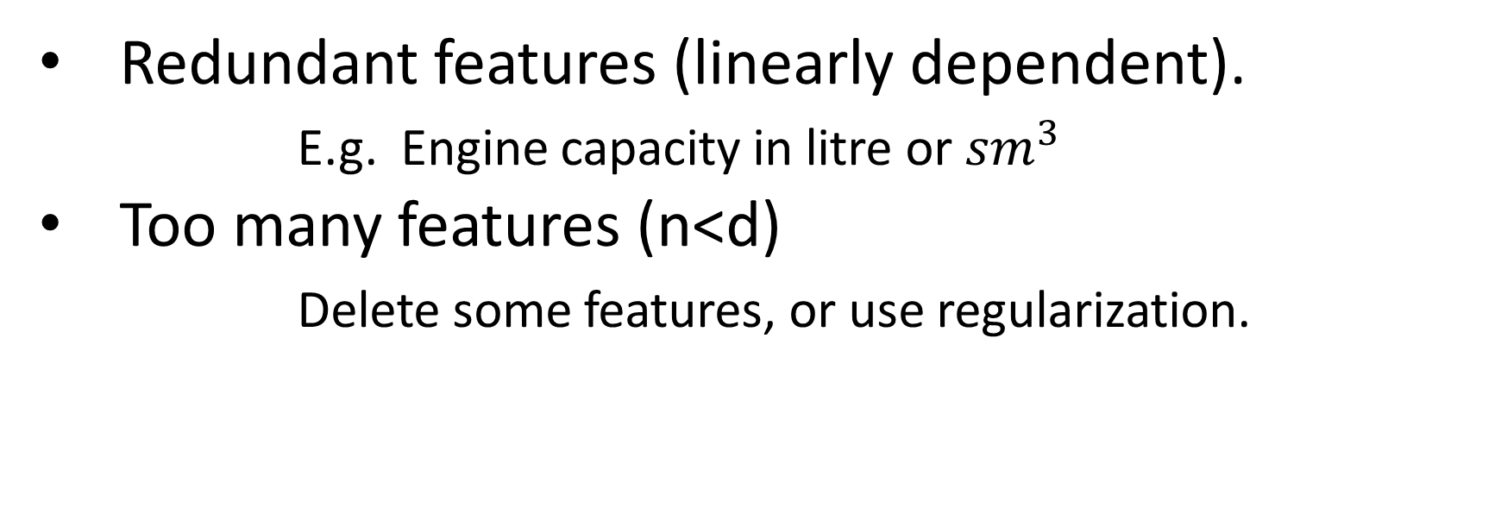
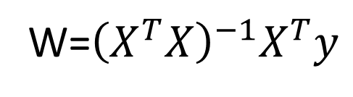
Normal equation
W=${\left(X^{T}X\right)}^{−1}X^{T}y$
What if $X^{T}X$ is non-invertible?(singular/degenerate)
Redundant features (linearly dependent).
E.g. Engine capacity in litre or ${sm}^{3}$
Too many features (n<d)
Delete some features, or use regularization.

Slide 24
A) X is 14×3, y is 14×1, W is 3×1
B) X is 14×4, y is 14×4, W is 4×4
C) X is 14×3, y is 14×1, W is 3×3
D) X is 14×4, y is 14×1, W is 4×1

Slide 25

Answer

Slide 26
A) X is 23×6, y is 23×6, W is 6×6
B) X is 23×6, y is 23×1, W is 6×1
C) X is 23×5, y is 23×1, W is 5×5
D) X is 23×5, y is 23×1, W is 5×1

Slide 28
A) The normal equation, since it provides an efficient way to directly find the solution.
B) Gradient descent, since will be very slow to compute in the normal equation.
C) The normal equation, since gradient descent might be unable to find the optimal W.
D) Gradient descent, since it will always converge to the optimal W.

Slide 29

Answer

Slide 30
A) It is necessary to prevent gradient descent from getting stuck in local optima.
B) It speeds up gradient descent by making each iteration of gradient descent less expensive to compute.
C) It speeds up gradient descent by making it require fewer iterations to get to a good solution.
D) It prevents the matrix (used in the normal equation) from being non-invertable (singular/degenerate).
E) It speeds up solving for W using the normal equation.

Slide 32
Reading Material:
Andrew Ng. Supervised learning. http://cs229.stanford.edu/notes2019fall/cs229-notes1.pdf
Machine Learning Crash Course by Google.
https://developers.google.com/machine-learning/crash-course

